Slide 1

Bangladesh University of Engineering and Technology
ME 174 (CSE): Mechanical Engineering Drawing & CAD
Lecture 2: Dimensioning
Course Teachers:
Shahriar Alam, Assistant Professor
Taslima Hossain Sanjana, Adj. Lecturer
Department of Mechanical Engineering, BUET

Slide 2
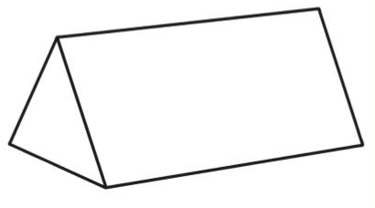
Front

Slide 3
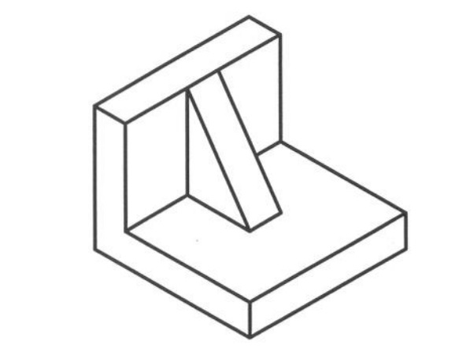
Front

Slide 4
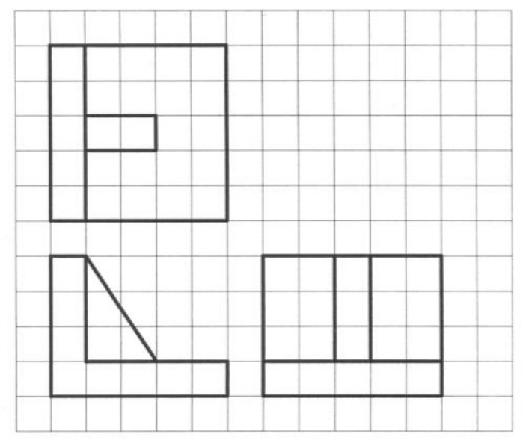

Slide 5
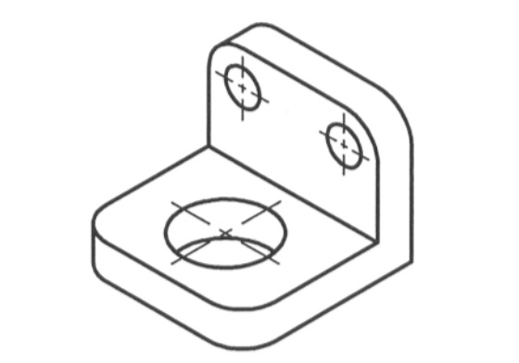
Front

Slide 6
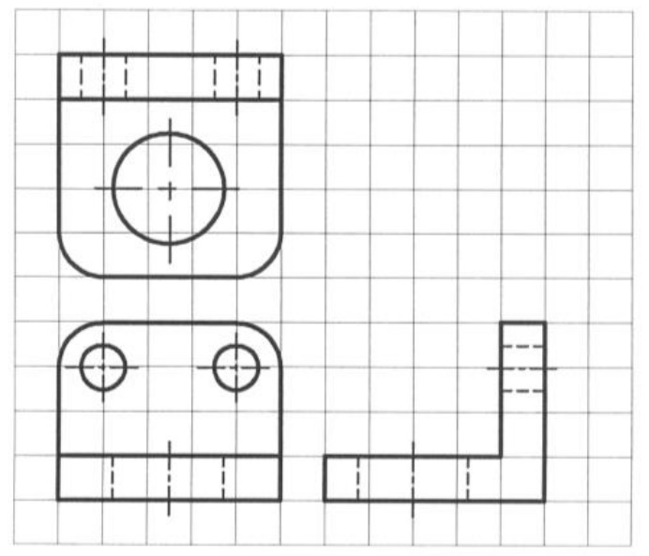

Slide 7
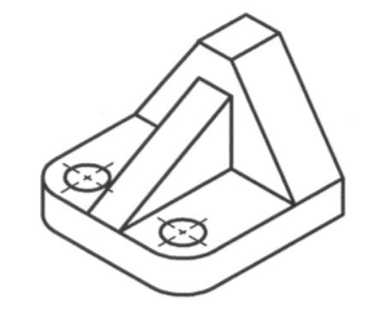
Front

Slide 8
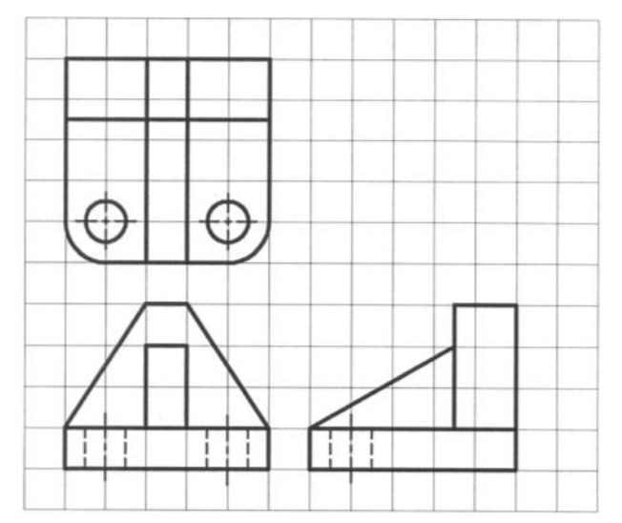

Slide 9
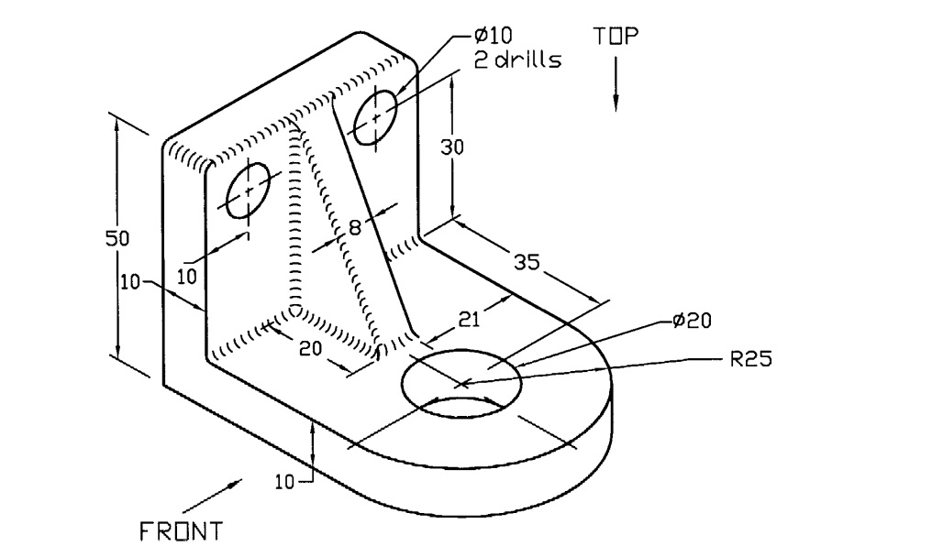

Slide 10
